Slide 1
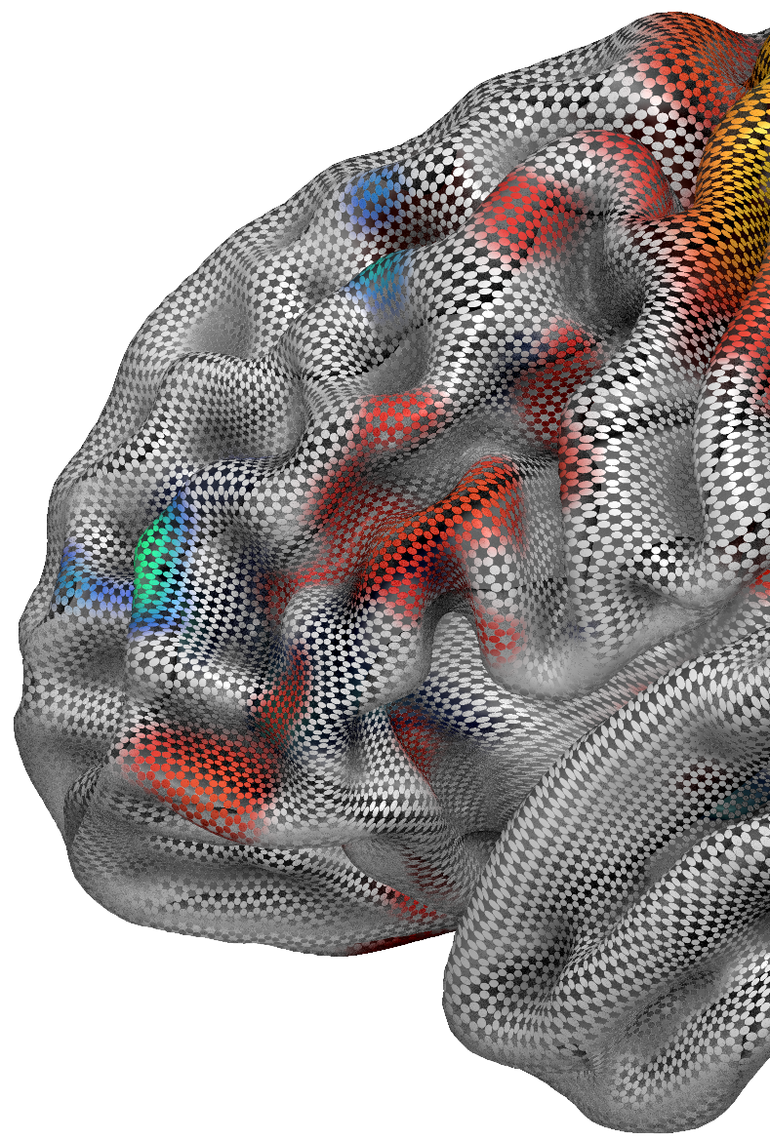

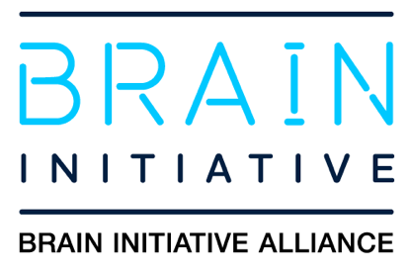
NiiVue Visualization
Chris Rorden
dcm2niix, MRIcro, MRIcron, MRIcroGL & Surfice creator Chris Drake, Taylor Hanayik
niiVue Lead developers
Franco Pestilli, Dan Levitas
ezBIDS & brainlife.io developers
University of South Carolina
Center for the Study of Aphasia Recovery
NIH RF1-MH133701, P50-DC014664

Slide 2
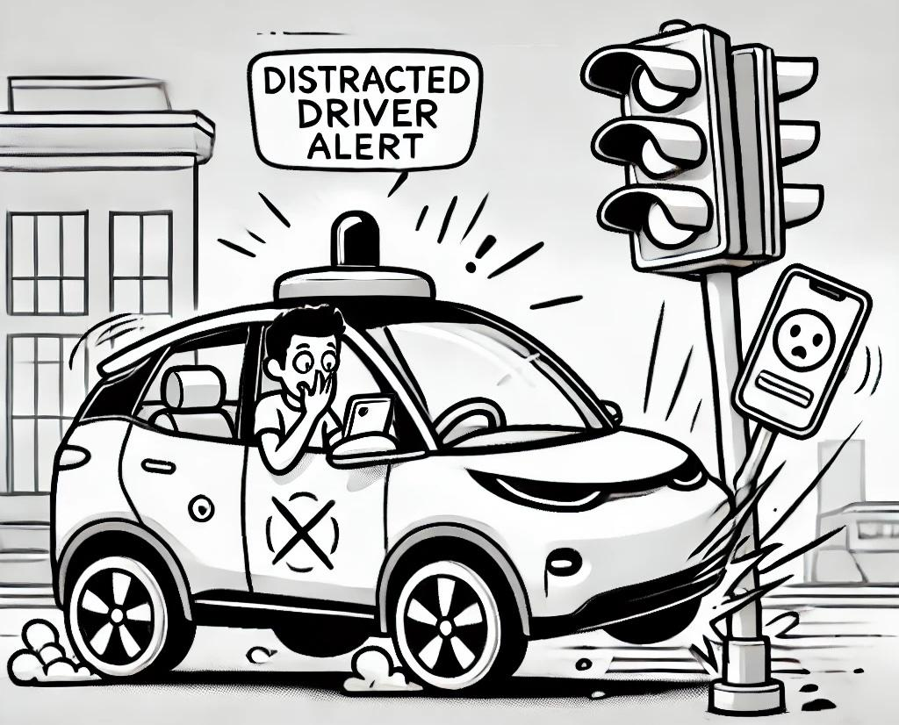
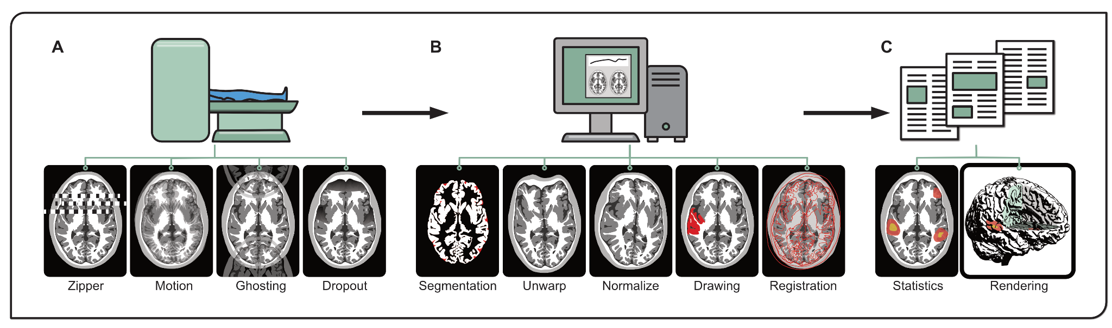
Motivation
MRI pipelines as self driving cars: generally robust but require human intervention to avoid catastrophic errors.
Visualization crucial for all stages (acquisition, processing, inference and dissemination) of neuroimaging.
Popular tools not web-capable and incompatible with each other.

Slide 3
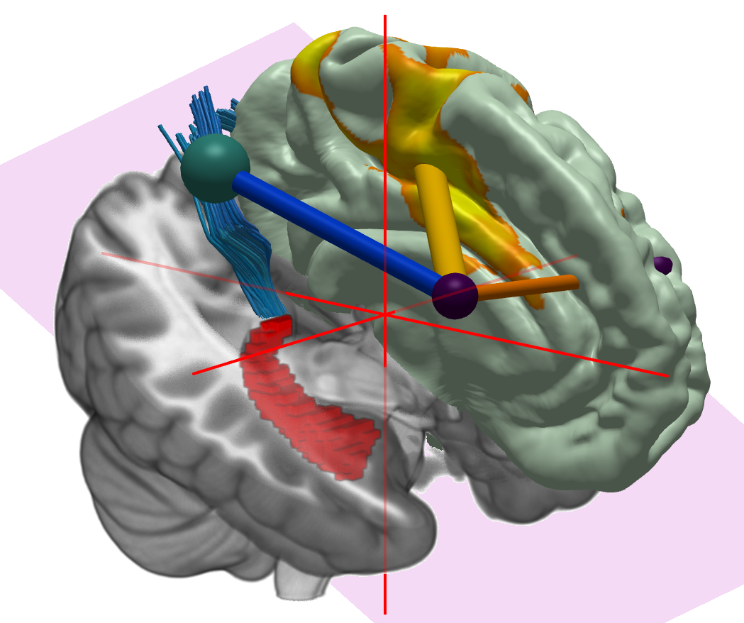
Need for Domain Specific Visualization
Neuroimaging has (unique) formats.
Voxels, meshes, gantry tilt, atlases, statistical maps, diffusion streamlines, connectomes.
While most tools support some common formats (DICOM, NIfTI, GIFTI, TRX), most tools use proprietary formats.
Mesh overlay
Mesh
Connectome
Streamlines
Voxel overlay
Voxels

Slide 4
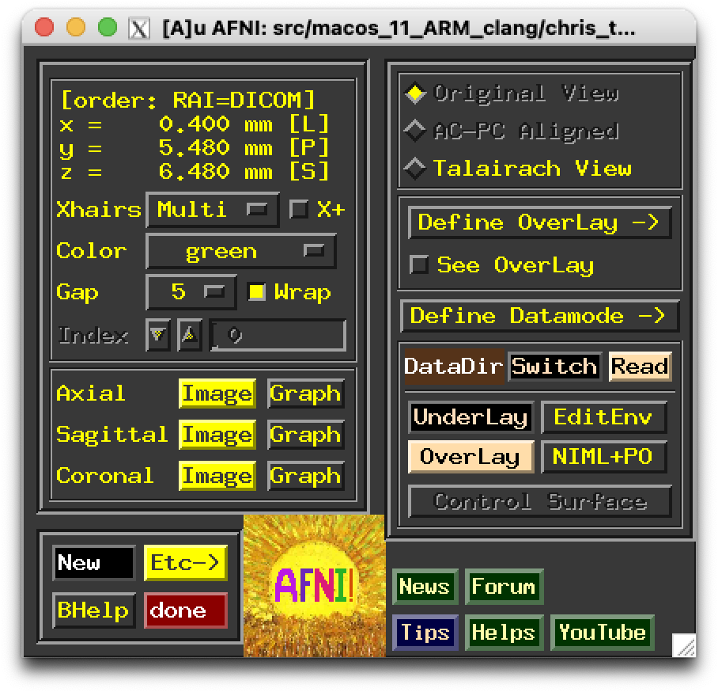
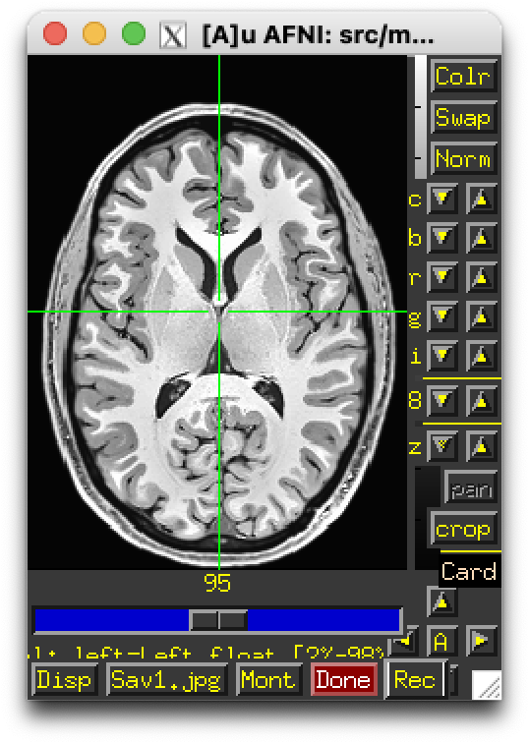
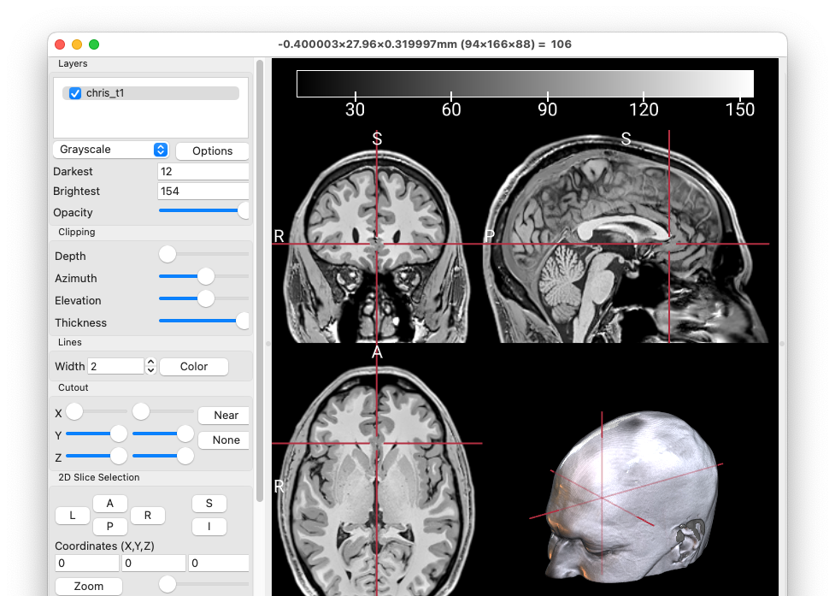
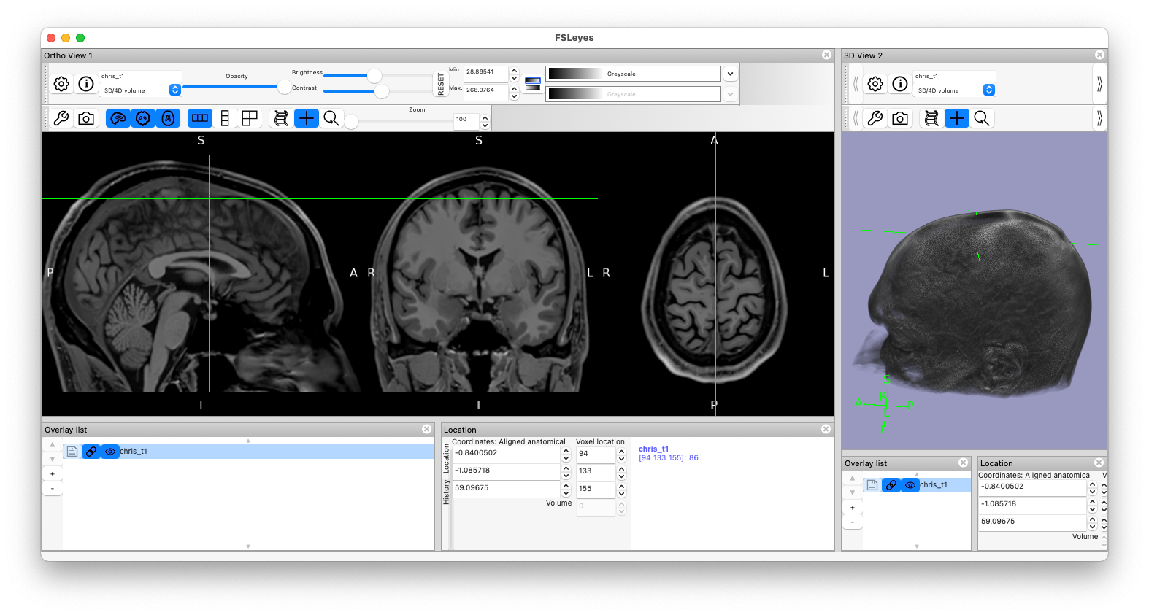
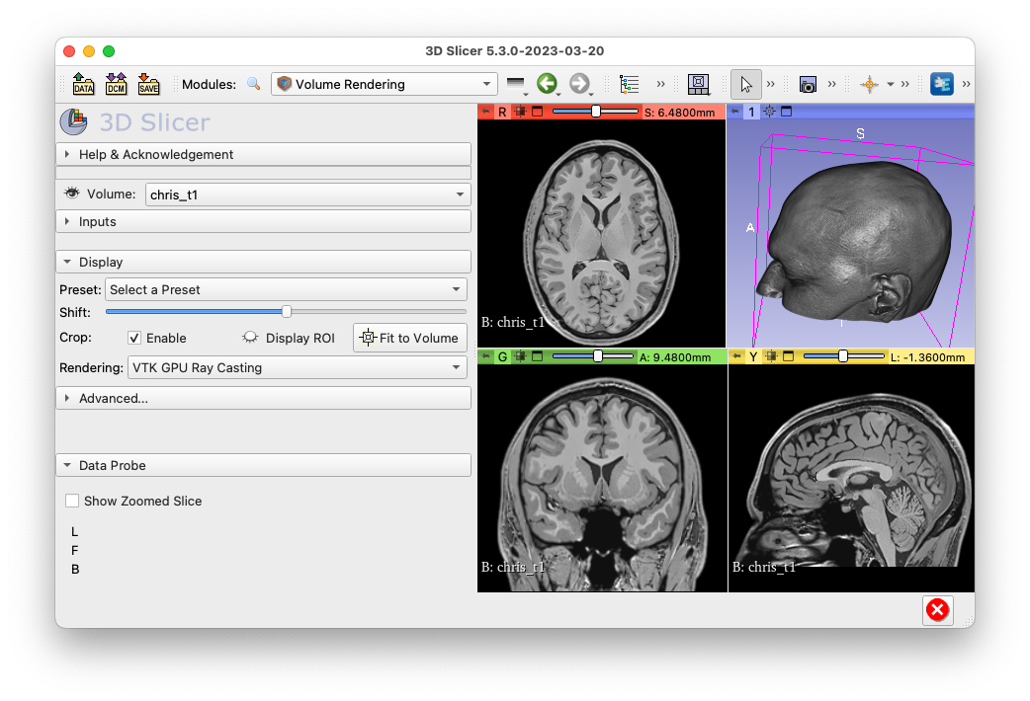
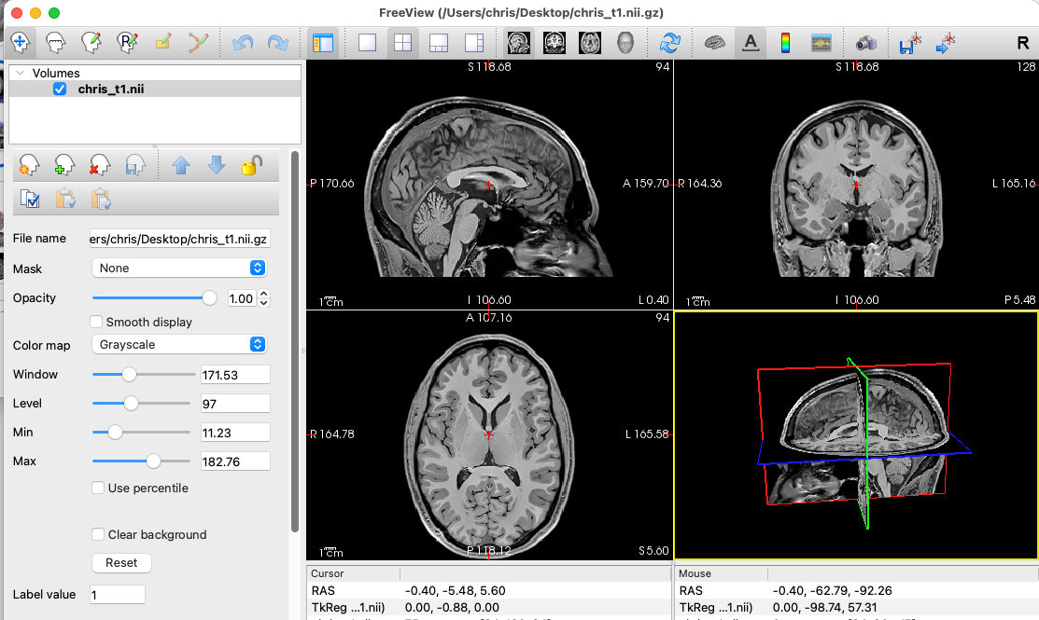
Limitation of popular solutions
Desktop-based:
Unsuitable for cloud or edge deployment.
Complicated:
Overwhelming user interfaces.
Inconsistent:
Different formats.
Skills don’t transfer easily.
Redundant maintenance efforts.

Slide 5
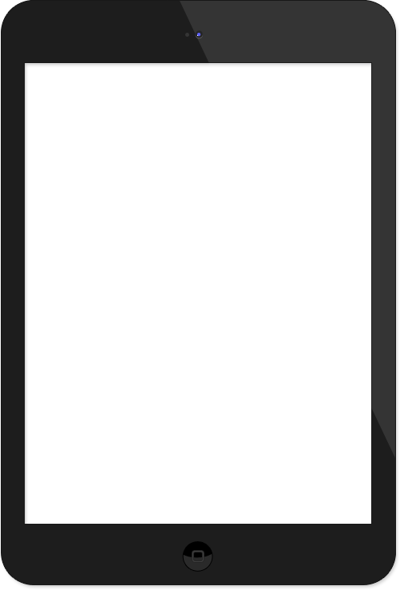
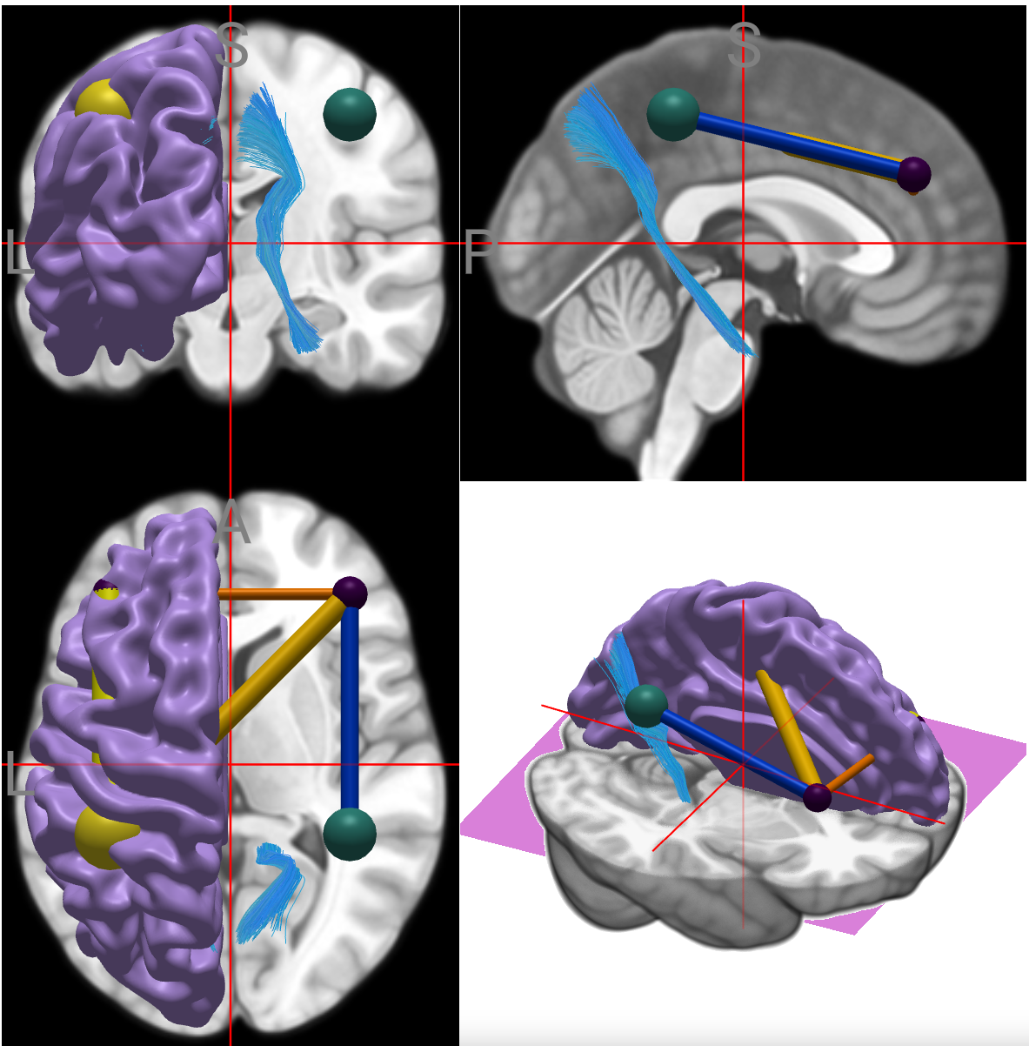
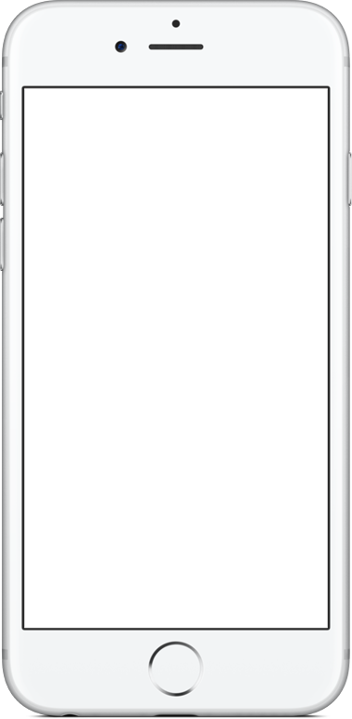
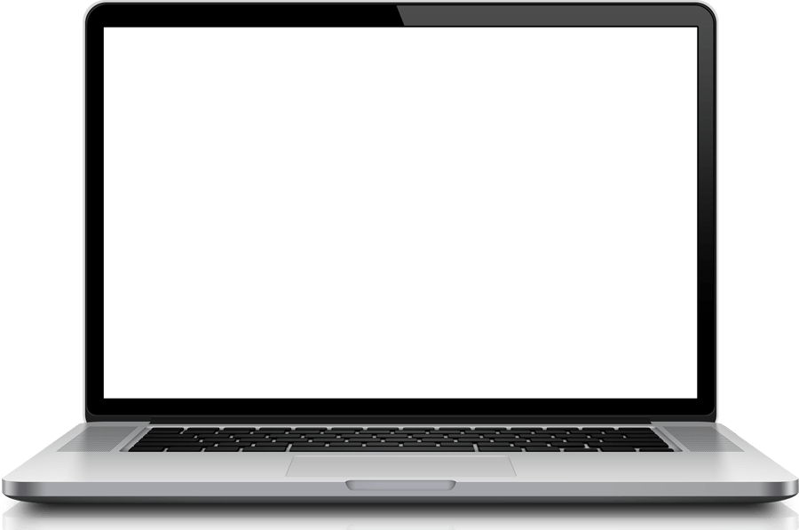
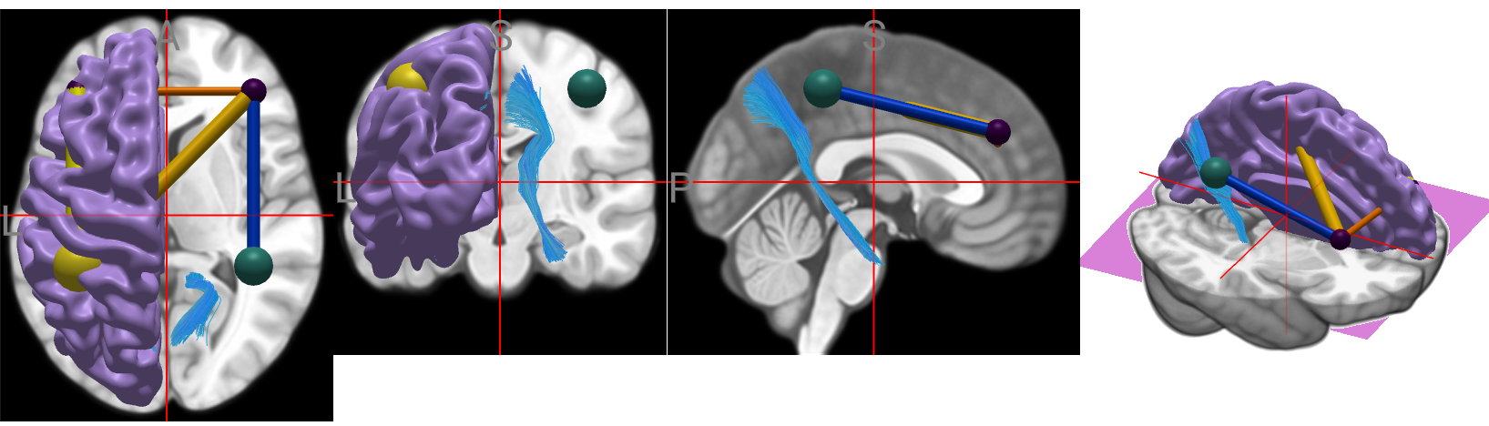
Vision: web-based neuroimaging visualization
Zero footprint neuroimaging can democratize science, scale on demand.
Support any devices:
Computer: General purpose.
Tablet: Drawing lesions.
Phone: QA for cloud processing.

Slide 6
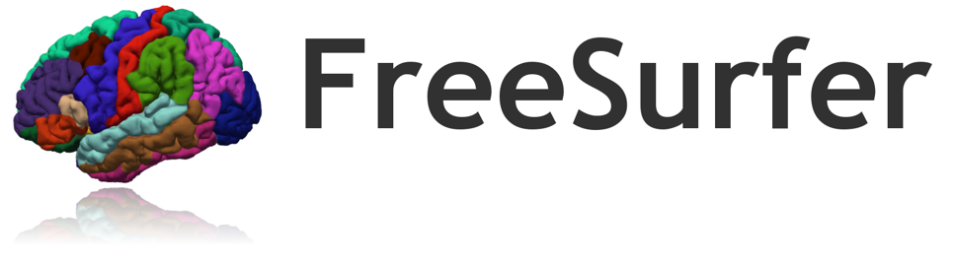
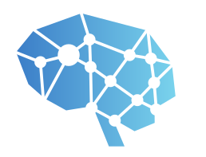


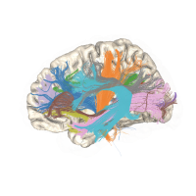

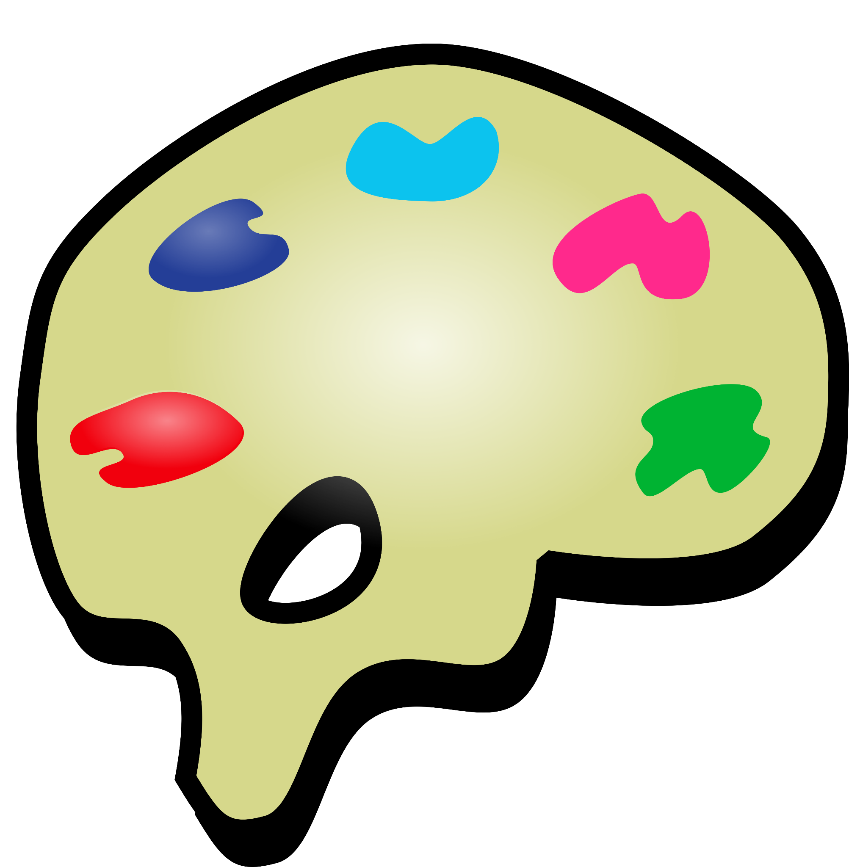
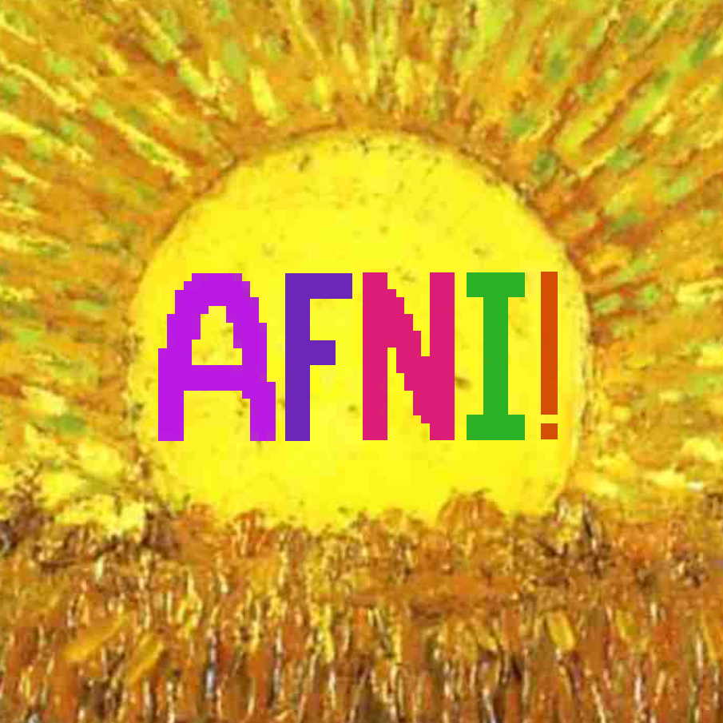



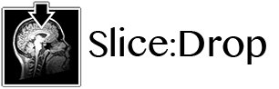

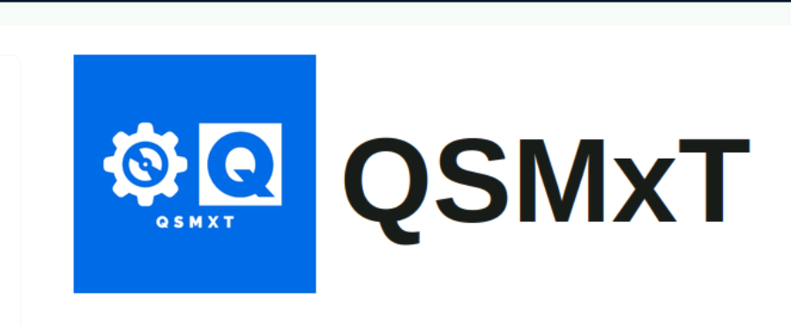
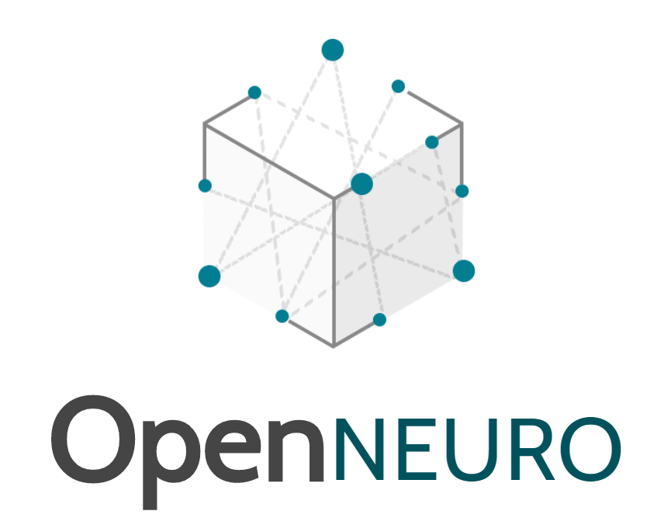
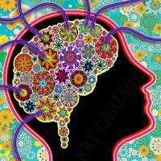
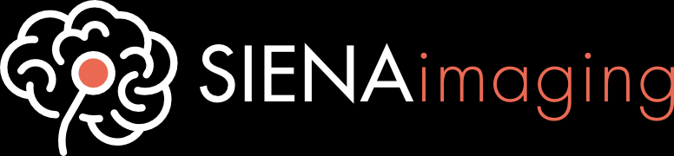

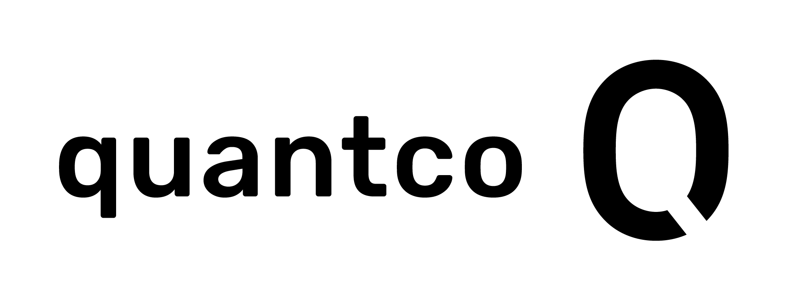

Community Driven Data Visualization
Team leverages collective wisdom of traditionally isolated and competing teams.
Modular can be embedded into HTML, react, angular, Vue, and native applications (Swift, Electron).
Next slides are a selection of case studies.

Slide 7
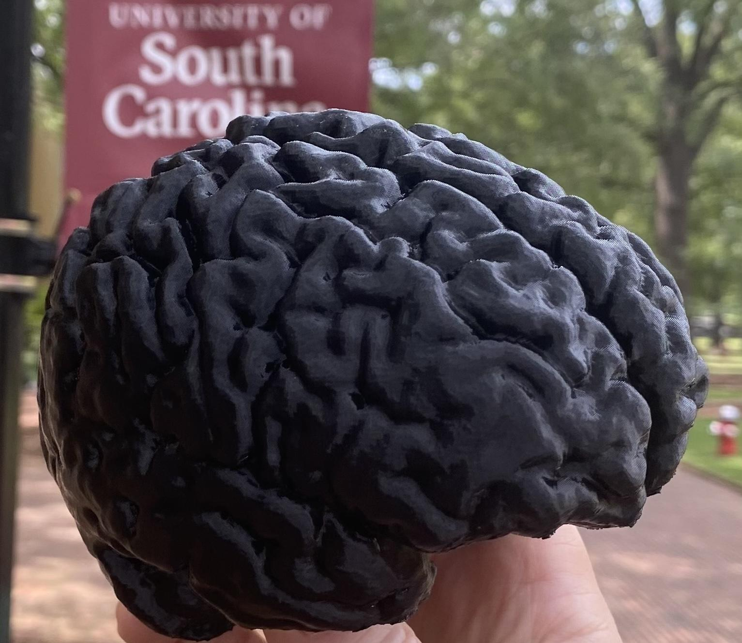
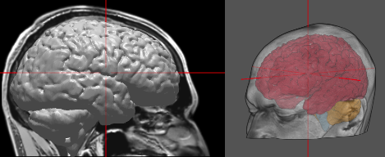
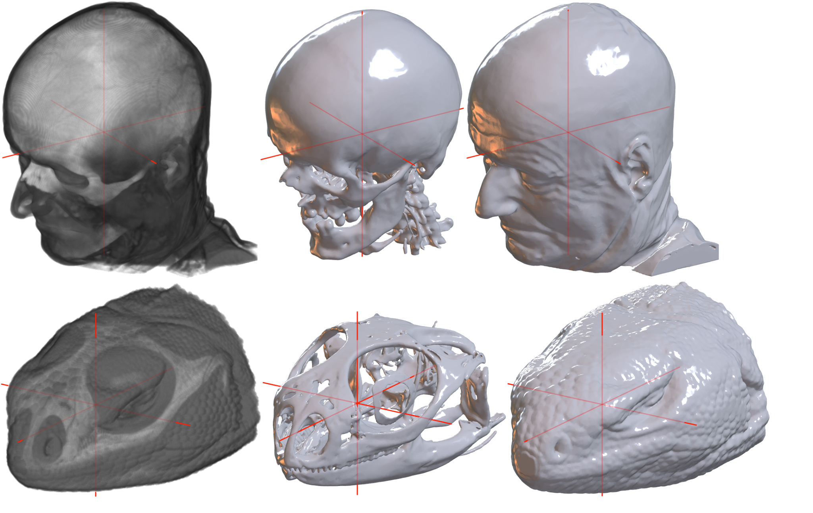
NiiVue in the wild 1 • brain2print.org
A tool to automatically segment MRI and send them to 3D printers
brainchop models can segment the brain in seconds.
our nii2mesh and niimath tools can be compiled to web assembly.
Combine these for a drag-and-drop zero footprint solution to convert MRI scans to printable models in seconds.
PMID: 39301517

Slide 8

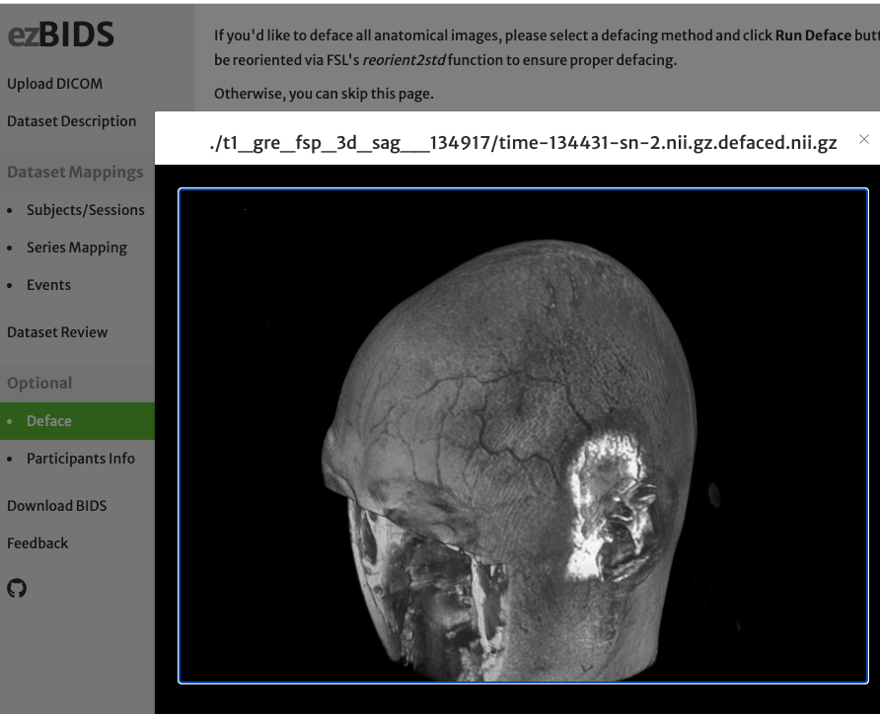
NiiVue in the wild 2 • brainlife ezBIDS
A tool to guide users to standardize brain data
Aid creation of BIDS datasets.
Integrates our dcm2niix.
Easy import to cloud processing (soon on edge).
NiiVue volume rendering provides QA for defacing.
PMID: 3860511

Slide 9
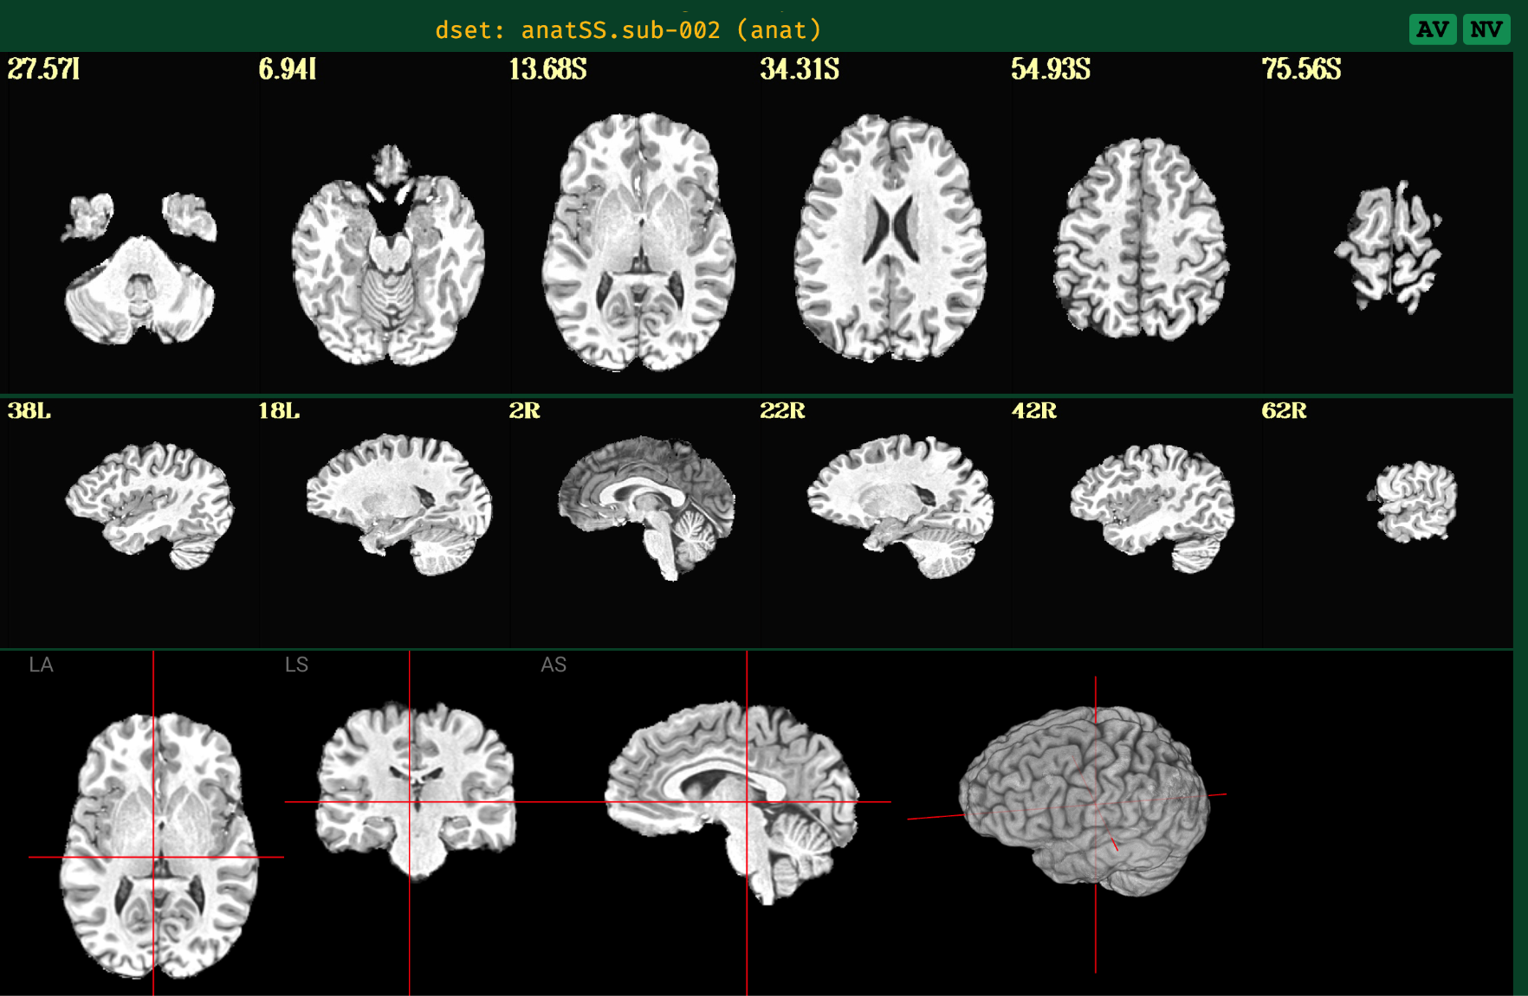
NiiVue in the wild 3 • AFNI QC
Quality Control and Annotation
Quality control (QC) integrated with AFNI framework.
Live demo
https://afni.github.io/qc-demo-repo/
PMID: 39257641

Slide 10
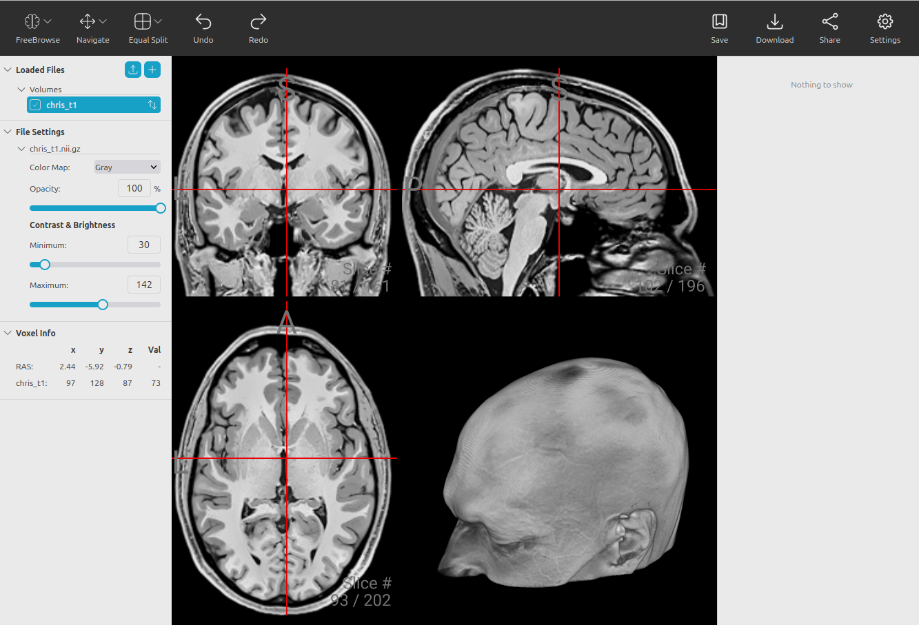
NiiVue in the wild 4 • FreeSurfer FreeBrowse
View and edit FreeSurfer meshes and images
Browser-based version of FreeSurfer's Freeview.
Cloud capable, allowing integration with large and distributed backends. https://github.com/freesurfer/freebrowse

Slide 11
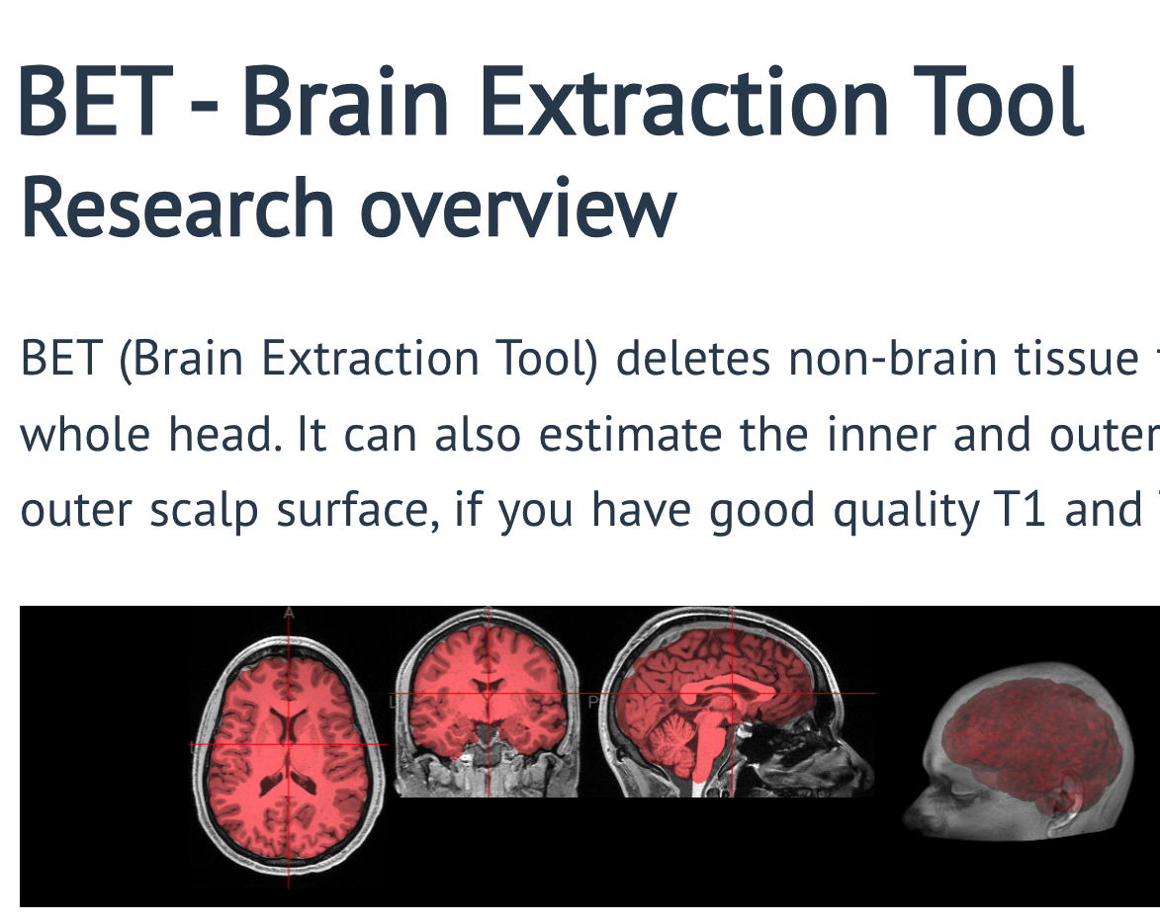
NiiVue in the wild 5 • FSL docs, FSL-UI
Interactive Documentation
Interactive documentation.
fslmaths, flirt, bet to WASM
Replace proven but aging FSL TCL FEAT interface with interactive, high-DPI and web capable user interface.
Replaces bash scripting with modern Python scripts.

Slide 12
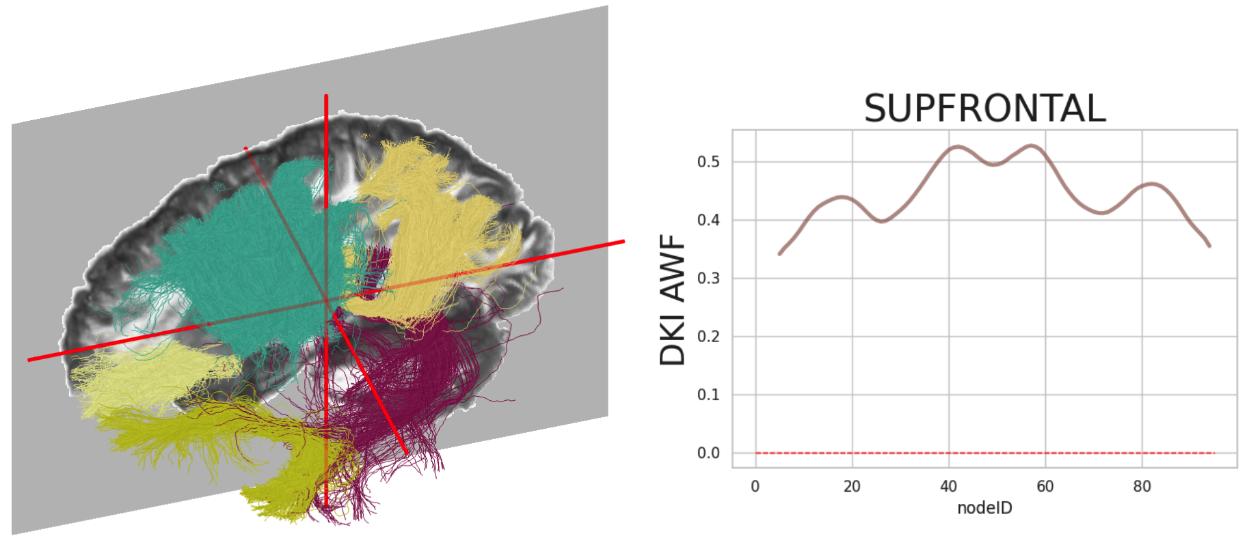
NiiVue in the wild 6 • nrdg tractoscope
A tool to explore preprocess white matter data
browser-based visualization tool for qsiprep and pyAFQ datasets.
Easy access to processed Healthy Brain Network and Human Connectome Project datasets.
Live deployment: https://nrdg.github.io/tractoscope/
PMID: 38933816

Slide 13
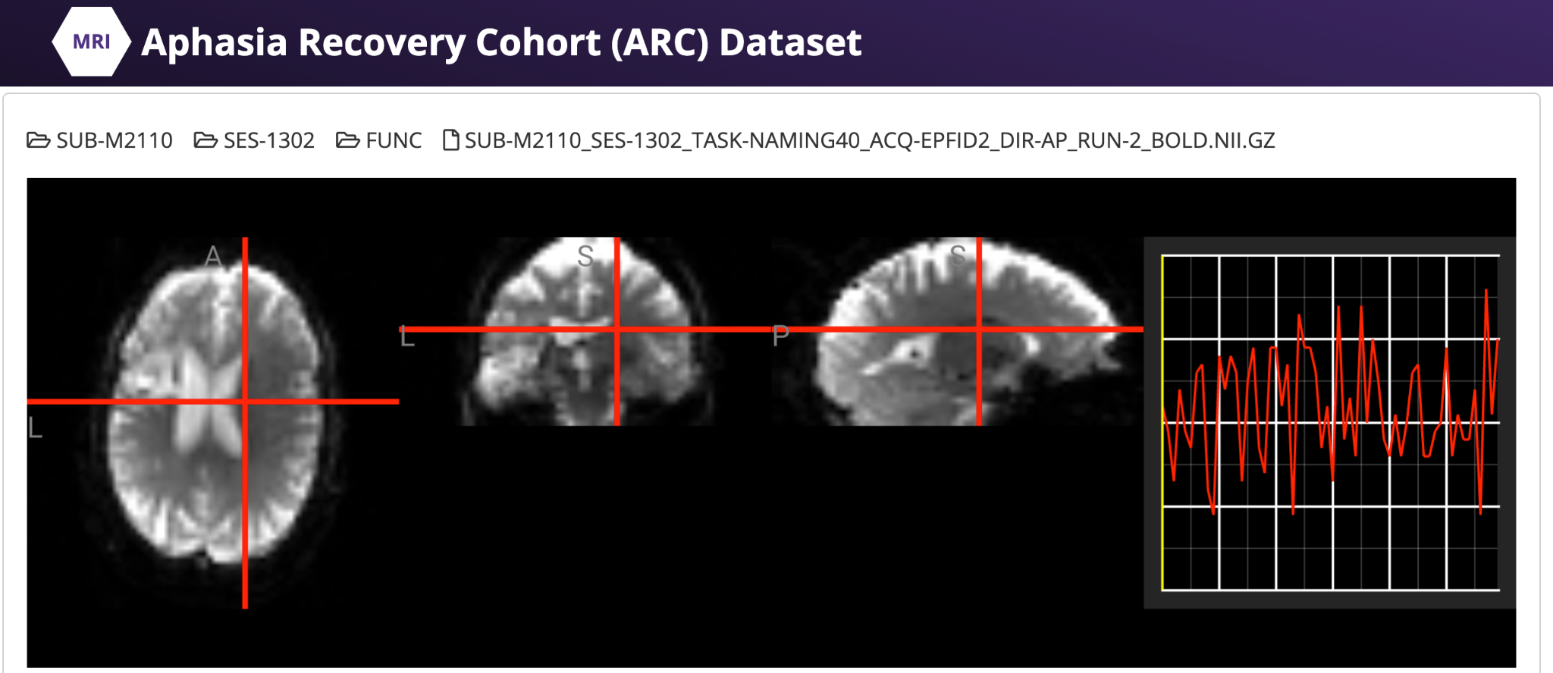
NiiVue in the wild 7 • OpenNeuro Viewer
A tool to visualize individual data files on OpenNeiro.org
Integrated NiiVue allows users to interactively inspect each dataset.
Live deployment https://openneuro.org/
doi.org/10.1162/imag_a_00103

Slide 14
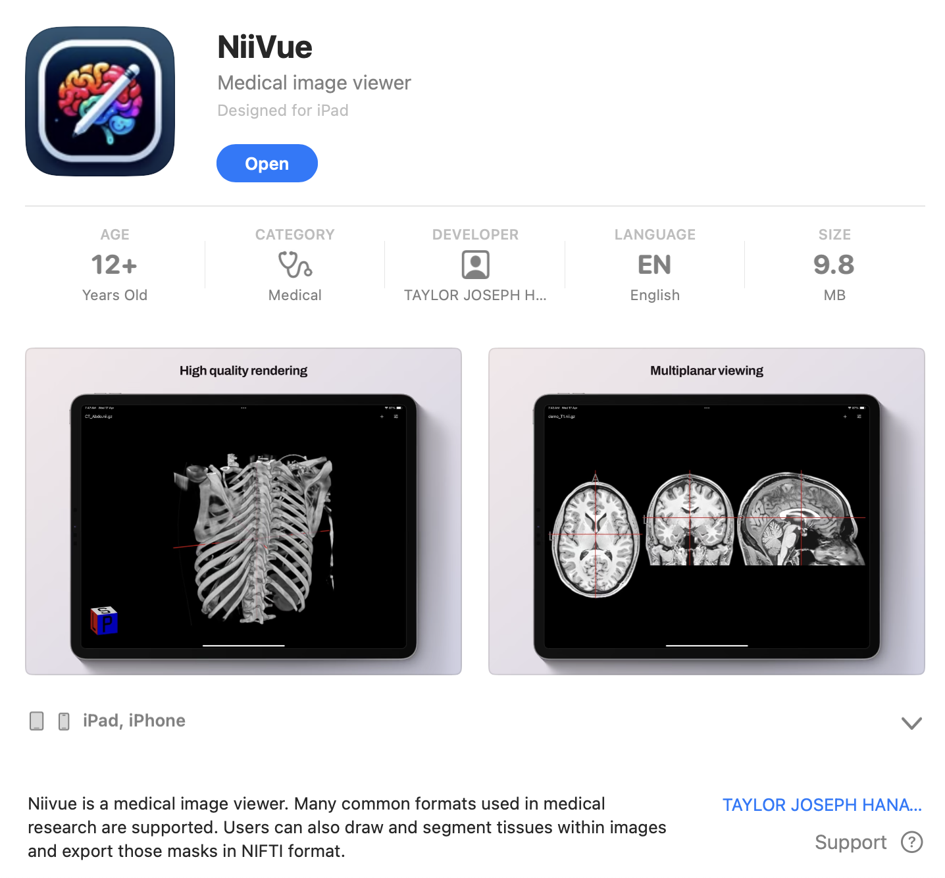
NiiVue in the wild 8 • iOS and MacOS app store
A desktop tool for viewing and editing neuroimaging data
Offline NiiVue with native user interface controls.
Swift wrapper for webkit.

Slide 15
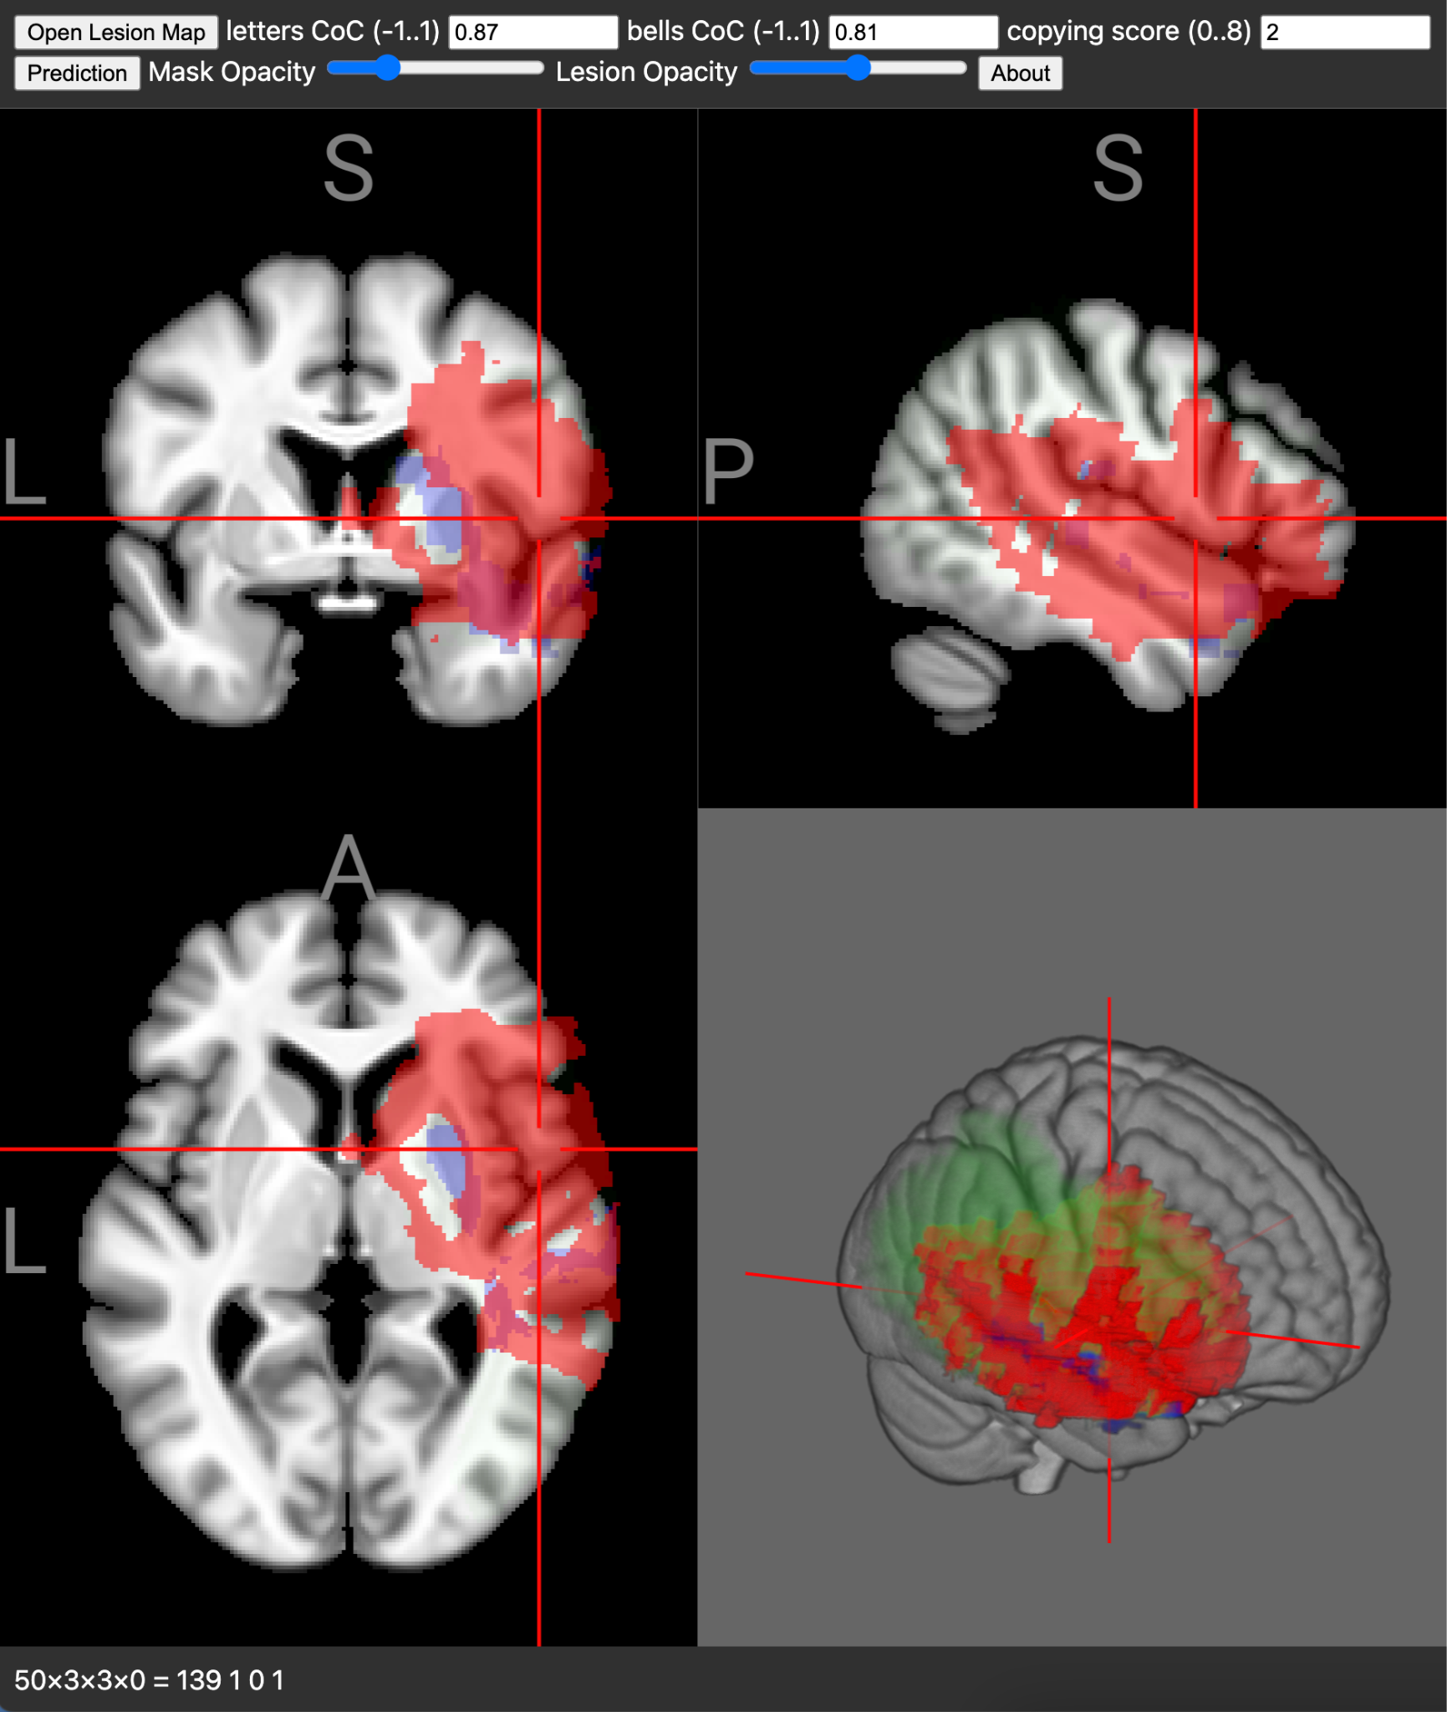

NiiVue in the wild 9 • Computer Aided Prognosis
A weblet to predict neglect recovery
Stroke leading cause of disability.
~50% of right hemisphere strokes results in spatial neglect.
While many recover, others left with long term disability.
Stroke location and acute impairment can be used synergistically to predict outcome.
Edge based solution allows clinical prediction without sharing data.

Slide 16
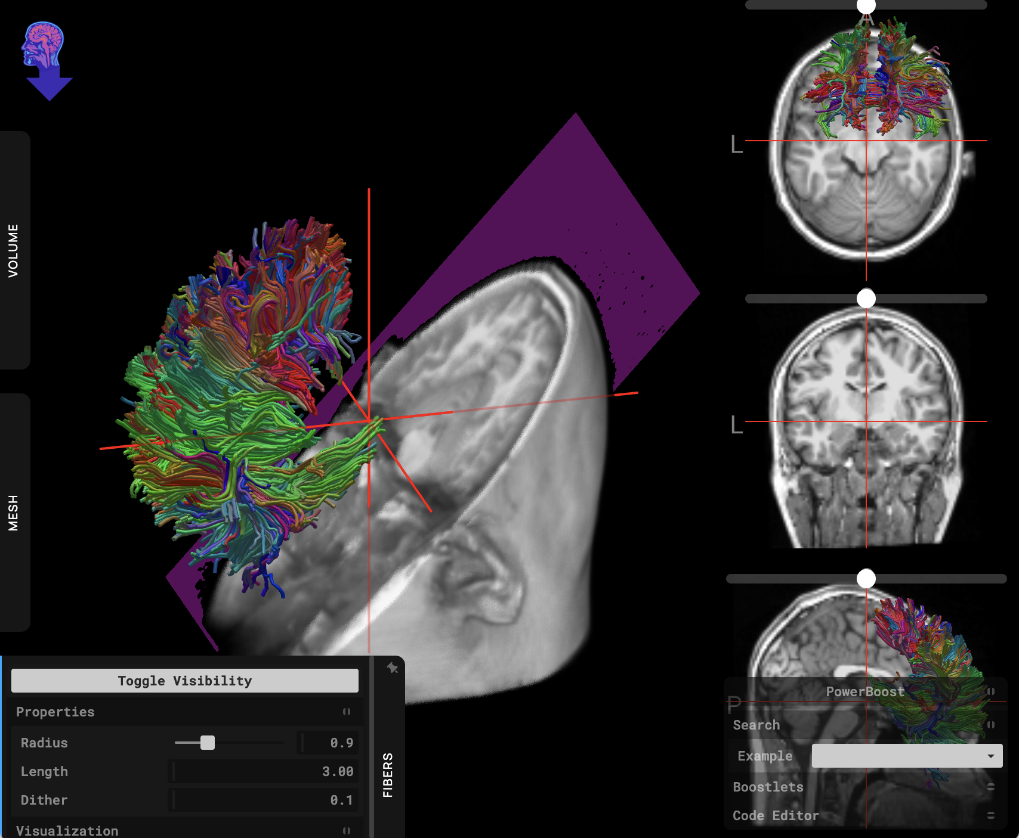
NiiVue in the wild 10 • Slice:Drop
Intuitive Medical Image Viewer
2013’s ‘Slice:Drop’ and its XTK library were seminal WebGL1 medical imaging tools.
NiiVue-based ‘Slice:Drop reloaded’ unleashes WebGL2 capabilities with same intuitive interface.

Slide 17
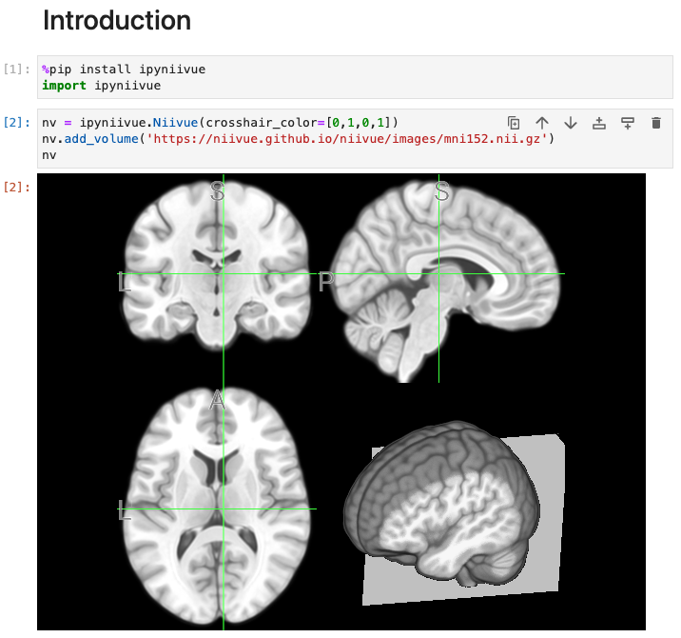
NiiVue in the wild 11 • ipyniivue
Neuroimaging visualization for jupyter notebooks
Python notebooks empower scientists.
Jupyter graphics must use web technologies.
Vision: pythonic interface for NiiVue.
Work In Progress. Actively seeking developers.

Slide 18
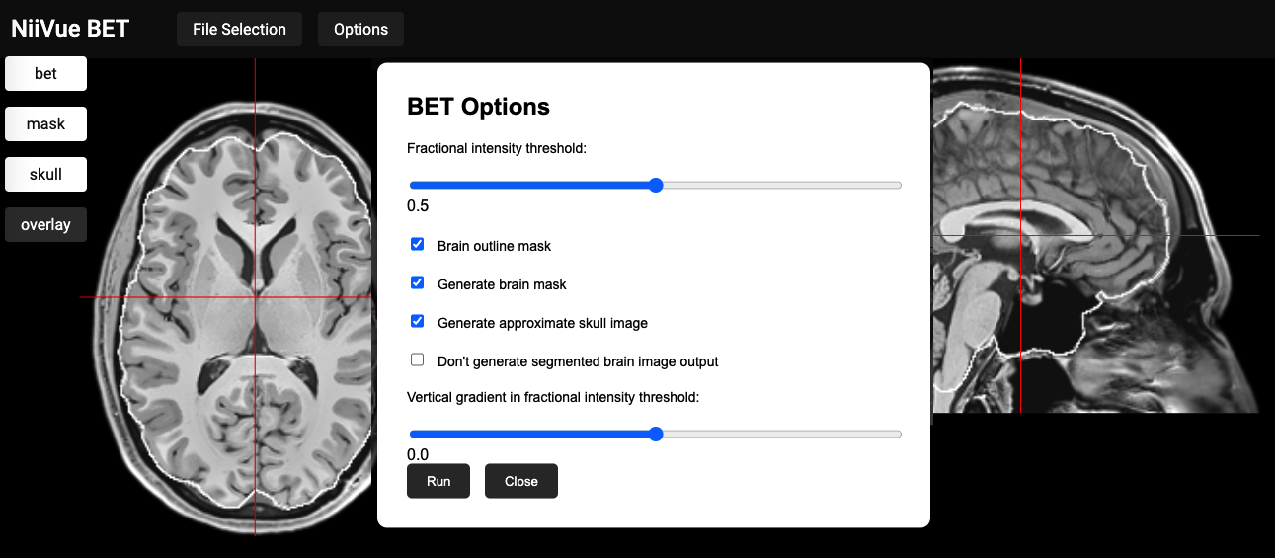
Feature plugins: proven modules to extend capabilities
WebAssembly for access to proven tools: bet, dcm2niix, fslmaths, flirt.
Supports itk-wasm packages for image processing including elastix and ants.
TensorflowJS, tinygrad and ONNX provide zero footprint AI model deployment regardless of users hardware or software.
AI for segmentation, parcelation, brain extraction, lesion identification and prognosis.
NiiVue can provide a visualization wrapper for proven and emerging tools.

Slide 19
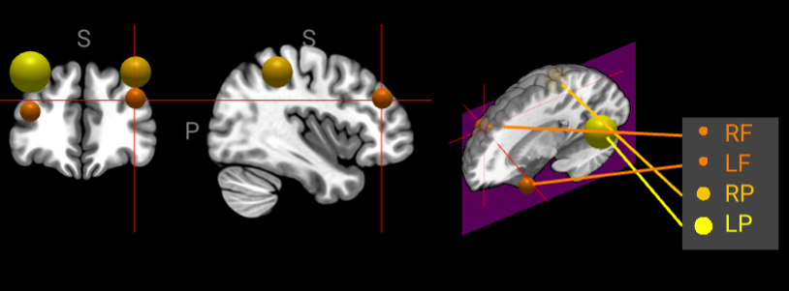
Feature documents: sharing scenes
NiiVue can save entire scene (voxels, meshes, contrast, landmarks, drawings) as a document or self-loading interactive web page.
Instead of sharing files, one have share the entire scene:
Correct AI failures.
Annotate images.
Homework tutorials.
Ask expert to describe anomaly.

Slide 20
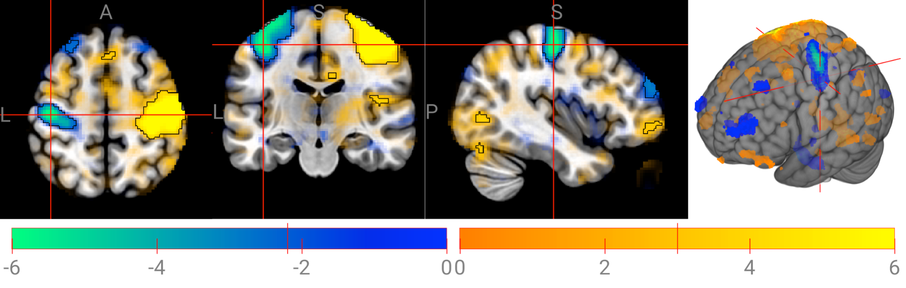
Feature statistics: highlight results, don't hide them
Accurate clinical familywise error correction with FDR and permutation will typically result in asymmetric thresholds.
Alpha-blending to show trends.

Slide 21
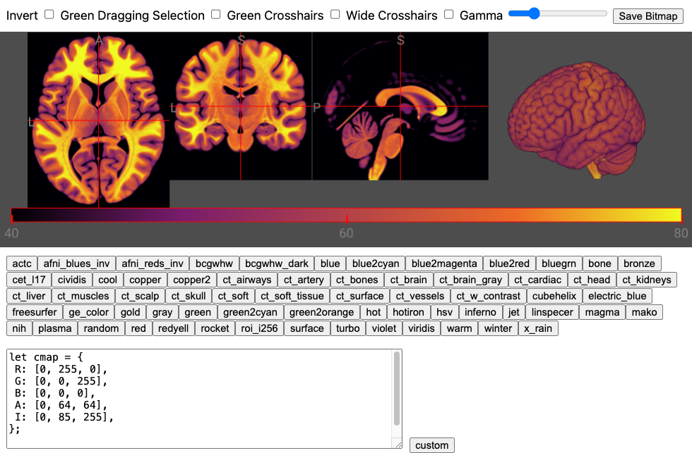
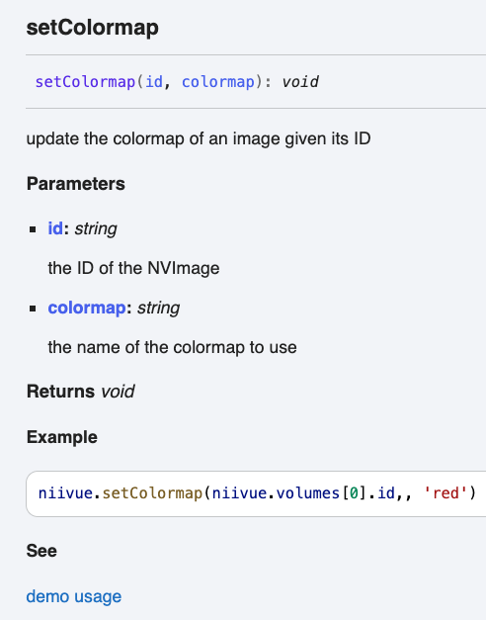
Why join the effort?
Developer Benefits:
JavaScript is a scripting language, so you can interactively write code.
Documentation links to minimal live demos. https://niivue.github.io/niivue/devdocs/

Slide 22

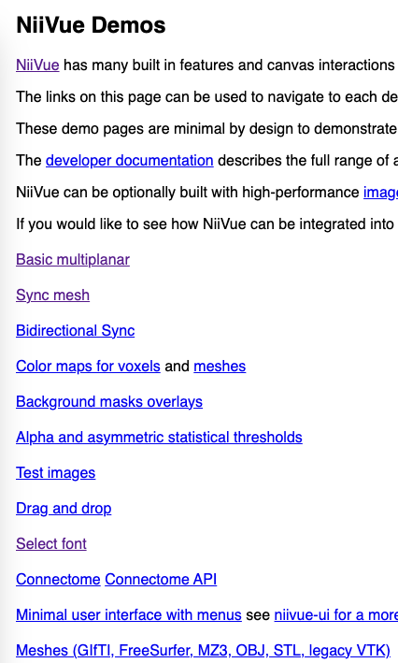
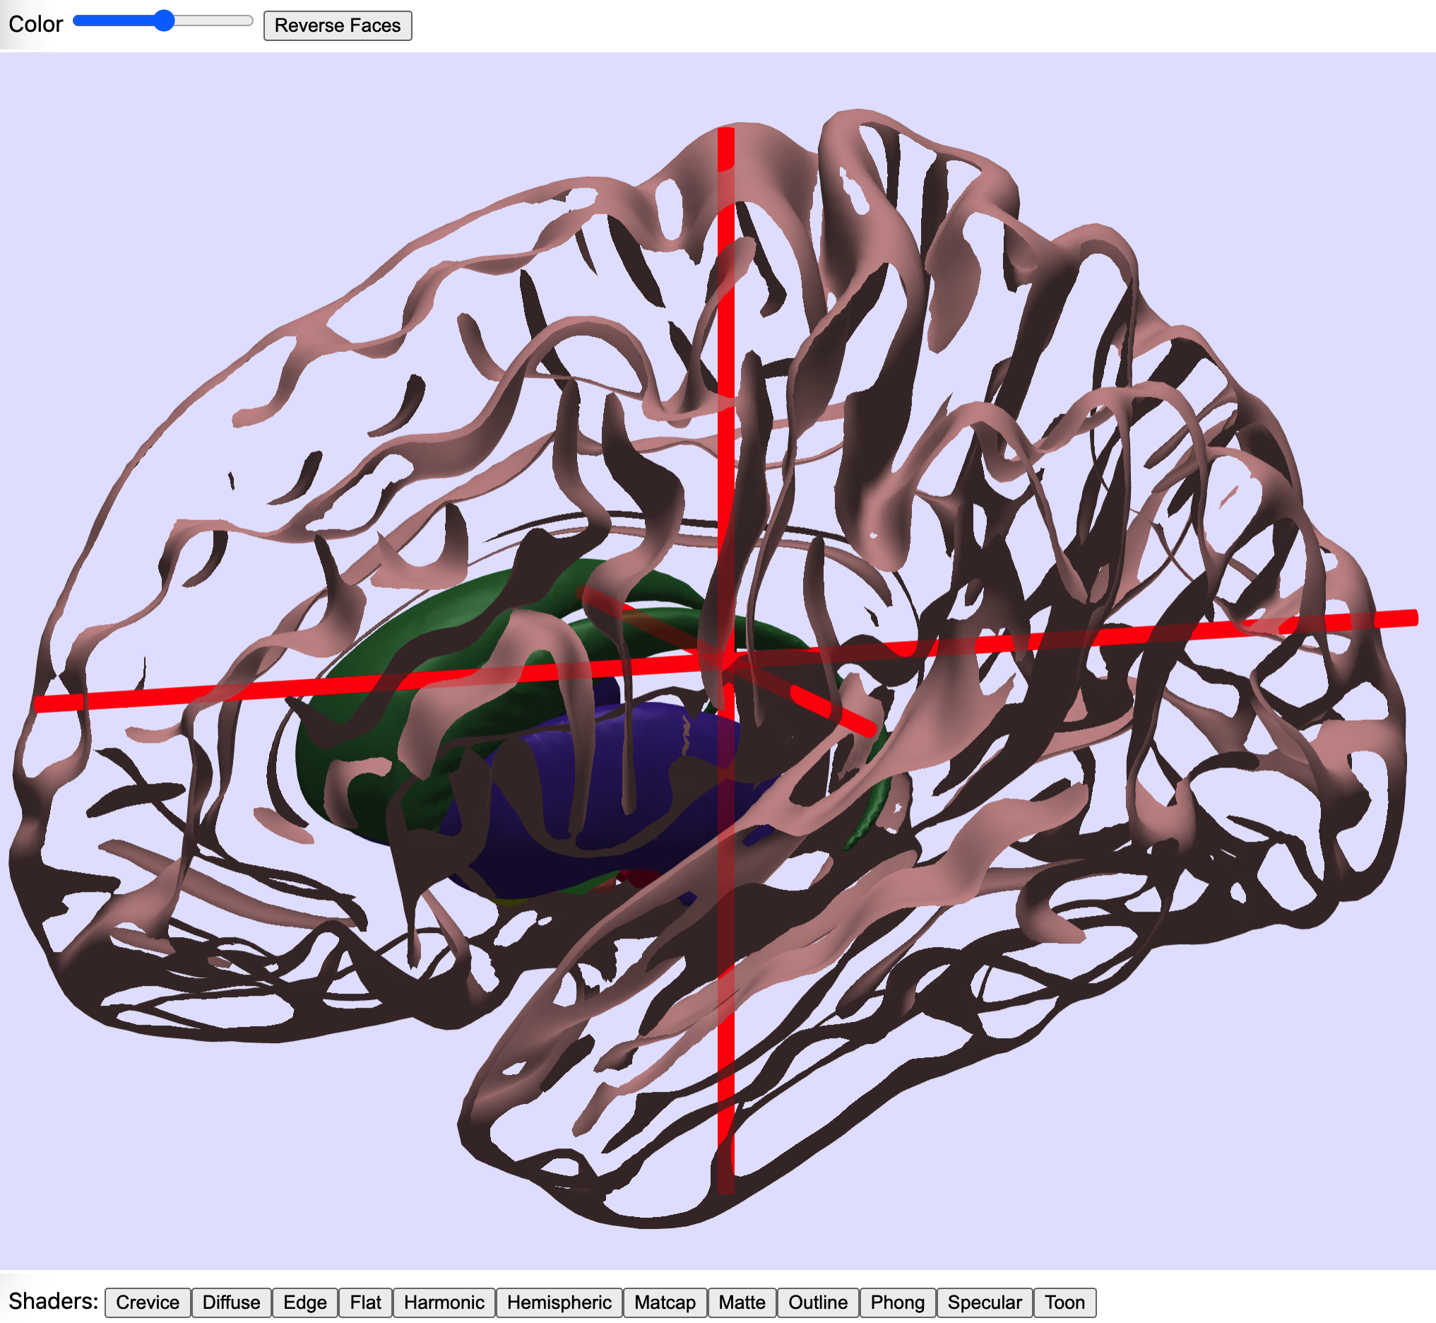
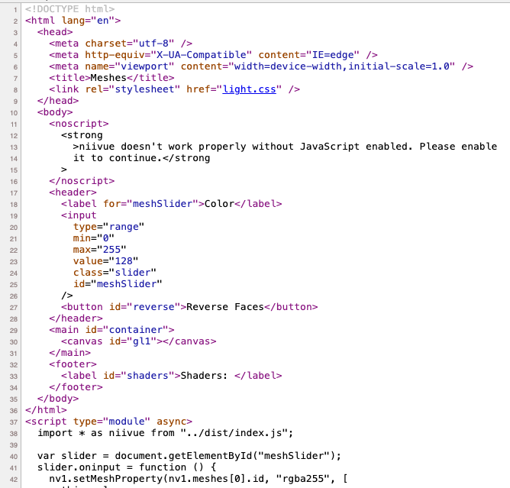
Collaborate 1: Explore Recipes niivue.github.io/niivue/
Existing live demos provide minimal examples of features.
View the web page source to duplicate features in your own projects.
Demos use pure HTML, so agnostic to framework (Angular, React, Vue).
Permissive license allows anyone to adopt NiiVue.

Slide 23
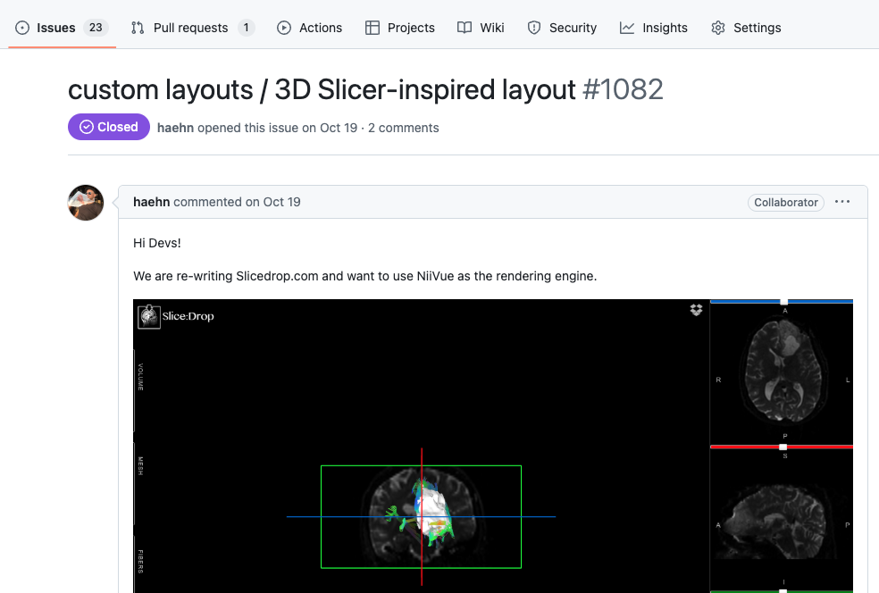
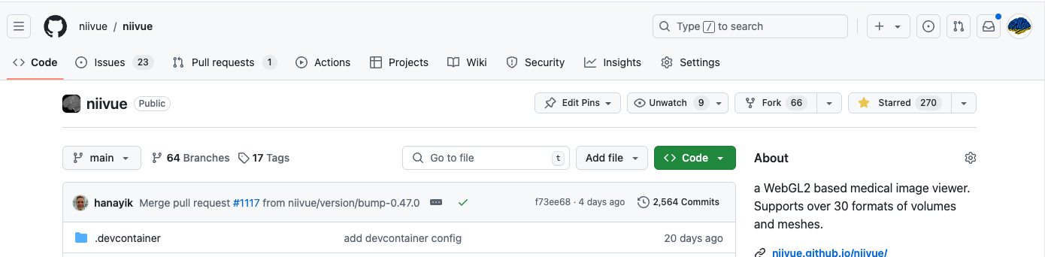
Collaborate 2: Communicate
Create a new issue for bug reports, feature requests, and advice.

Slide 24

Collaborate 3: Embed
Insert NiiVue into your own project.
NiiVue has minimal dependencies.
NiiVue can be extended with plugins.
Minimal demos provided
React, Angular, Vue frameworks.
ONNX and TensorflowJS AI models.
bet, flirt, dcm2niix, nii2mesh, itk-wasm web-assembly plug ins.
Extend supported formats, TRAKO, CBOR file loading plugins.

Slide 25

Collaborate 4: Develop
Hot reloadable development
Make sure git and node.js/npm installed.
Download, install and run NiiVue locally.
Saved edits instantly reflected in browser.
git clone git@github.com:niivue/niivue.git
cd niivue
npm install
npm run dev

Slide 26

Collaborate 5: Contribute
Fork the project to create your own branch.
You can share improvements to the main branch with a pull request.

Slide 27
Roadmap • Annual Themes • Questions
`24
`25
`26
Developers
Features
Edge
API
Users
Desktop App
iOS/Mac App
Jupyter
Refine UI
Cloud
Big Data Sharing
Federated
Any browser
Any OS
Any where

